Slide 1





EDUOLOGY
LMS
Supervised by
Dr. Basher Youssef
Graduation Project
Academic Year 2023-2024
Midyear Presentation

Slide 2
EDUOLOGY LMS
Supervised by
Dr. Basher Youssef
TA. Tasneem
Implemented by
Aliaa Mohamed Saad 20201120
Walaa Hassan Saad 20201217
Bassant Mahmoud Mohamed 20201043
Mohamed Hamdy Mohamed 20200442
Mohamed Ahmed Mahmoud 20200425
Graduation Project
Academic Year 2023-2024
Midyear Presentation

Slide 3
Agenda
01
Project Idea
02
Problem Significance
03
Project Specifications
04
Time Plan
05
Conclusion

Slide 4
01
PROJECT IDEA

Slide 5

Introduction
Idea
We address the challenge of improving traditional teaching methods with an Eduology LMS system. Our solution aims to enhance the learning experience through seamless interaction, collaboration, and information dissemination. Motivated by the gap between traditional and modern approaches
Domain of interest
Remote learning through web technologies
(Angular & .NET)

Slide 6

02
PROBLEM SIGNIFICANCE

Slide 7
PROBLEM SIGNIFICANCE
• The current education system faces challenges in providing an interactive
and efficient online learning platform. There is a need for a user-friendly Eduology-style system that simplifies the online learning experience,
promotes effective communication between educators and students, and enhances the overall digital learning environment

Slide 8
WHY?
• Making education easier, accessing materials at any time without being restricted to books, and getting rid of traditional methods makes it easier for instructors and teaching assistants to conduct tests and assignments

Slide 9
How?
Eduology will offer solutions for these difficulties
Make it easy to students to get materials and upload assignments online through internet

Slide 10

Previous Solutions
Eduology
Blackboard
Moodle
Scalability
User friendly
Efficient Assignment Management
Technological Stack
Open Source
User-Friendly Interface
Multilingual Support
Feature-Rich Platform
user-friendly interface
Mobile Accessibility:
Technical Expertise
Learning Curve
Feature Overload
Interface Design
Cost
Complexity
Updates and Downtime
Interface Design
10

Slide 11

Project Specifications

Slide 12
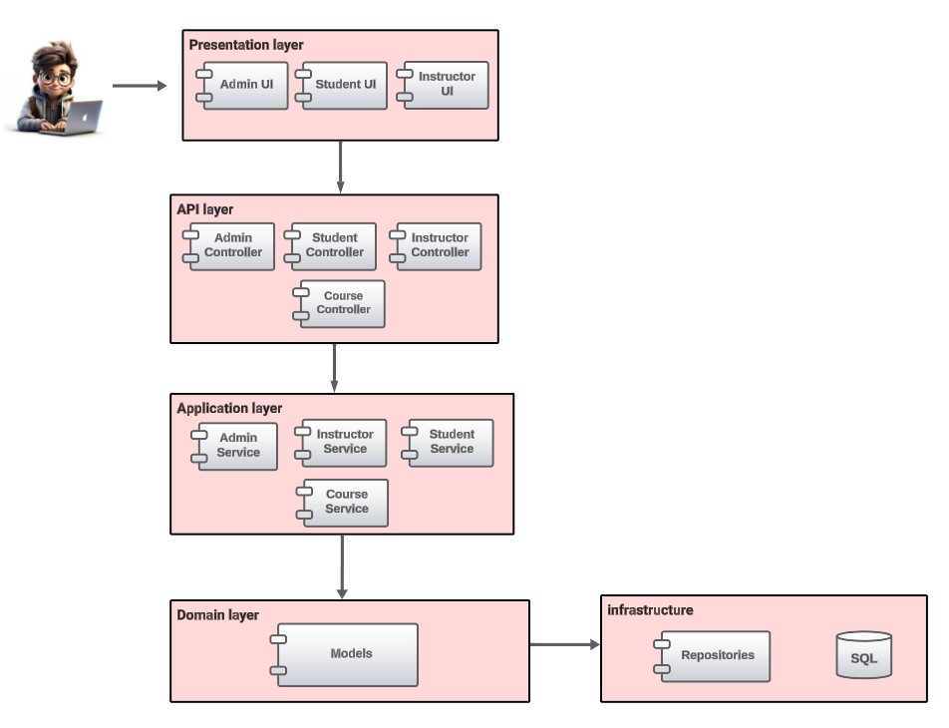
System Architecture
Layered architecture
Layers?
Presentation
Business
Database/persistence
Why?
Ease of development
Reduced dependency
Testing is easier

Slide 13

Stakeholders
CUSTOMERS
ADMIN
End user
Females
Above 18
Needs fashion advice
End user
Responsible for the system
Instructors/TAs
DEVELOPERS
End user
Responsible for the system(verify brands)
Collect data
Implement
Test
Maintain

Slide 14
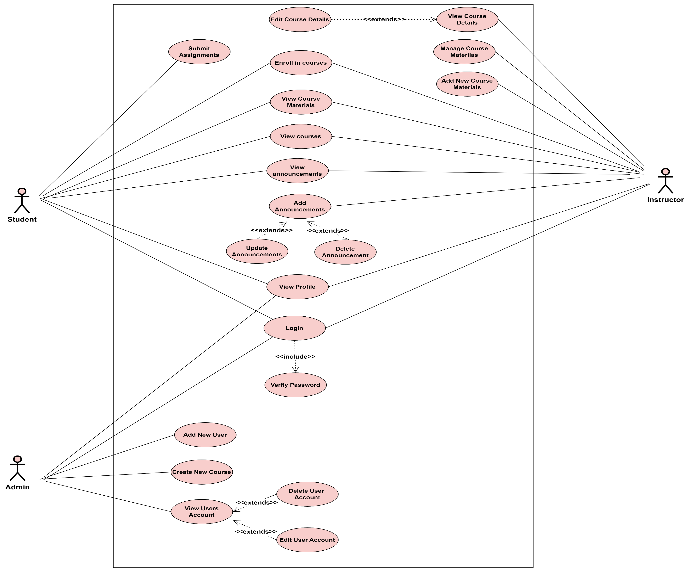
Use Case Diagram

Slide 15
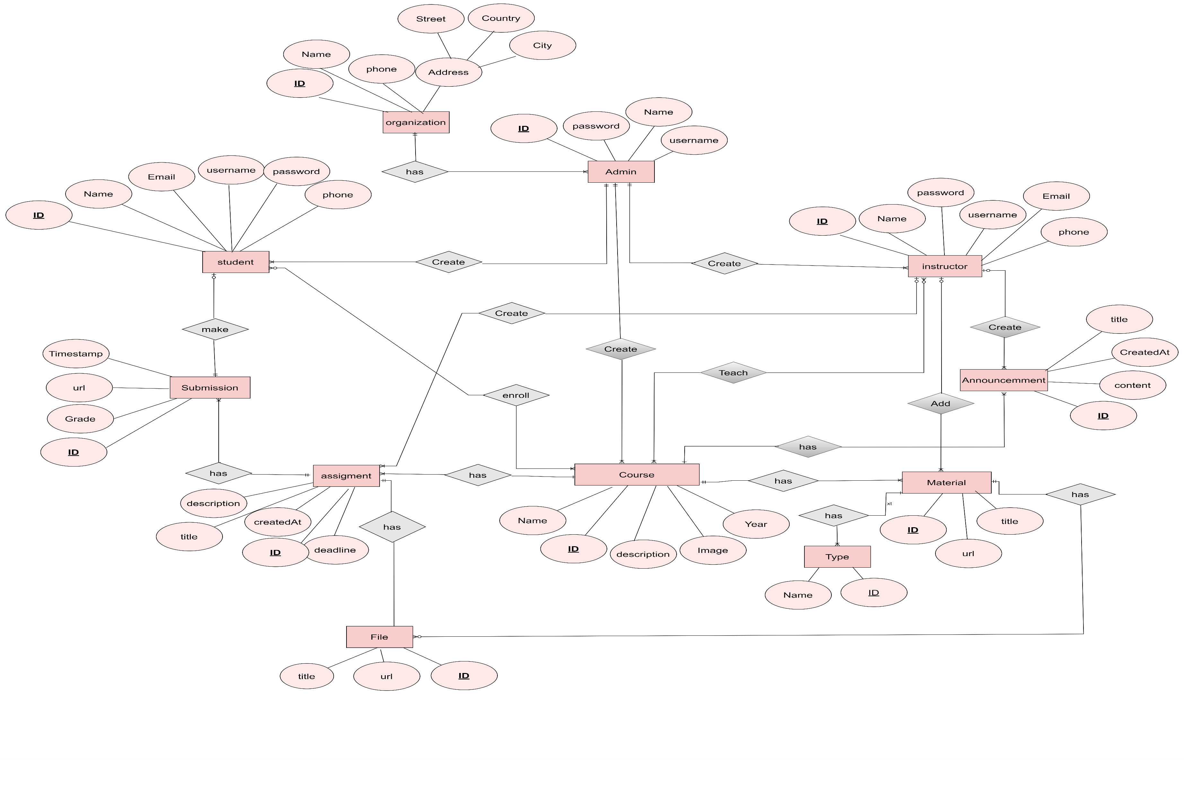
ERD

Slide 16
04
Time Plan

Slide 17
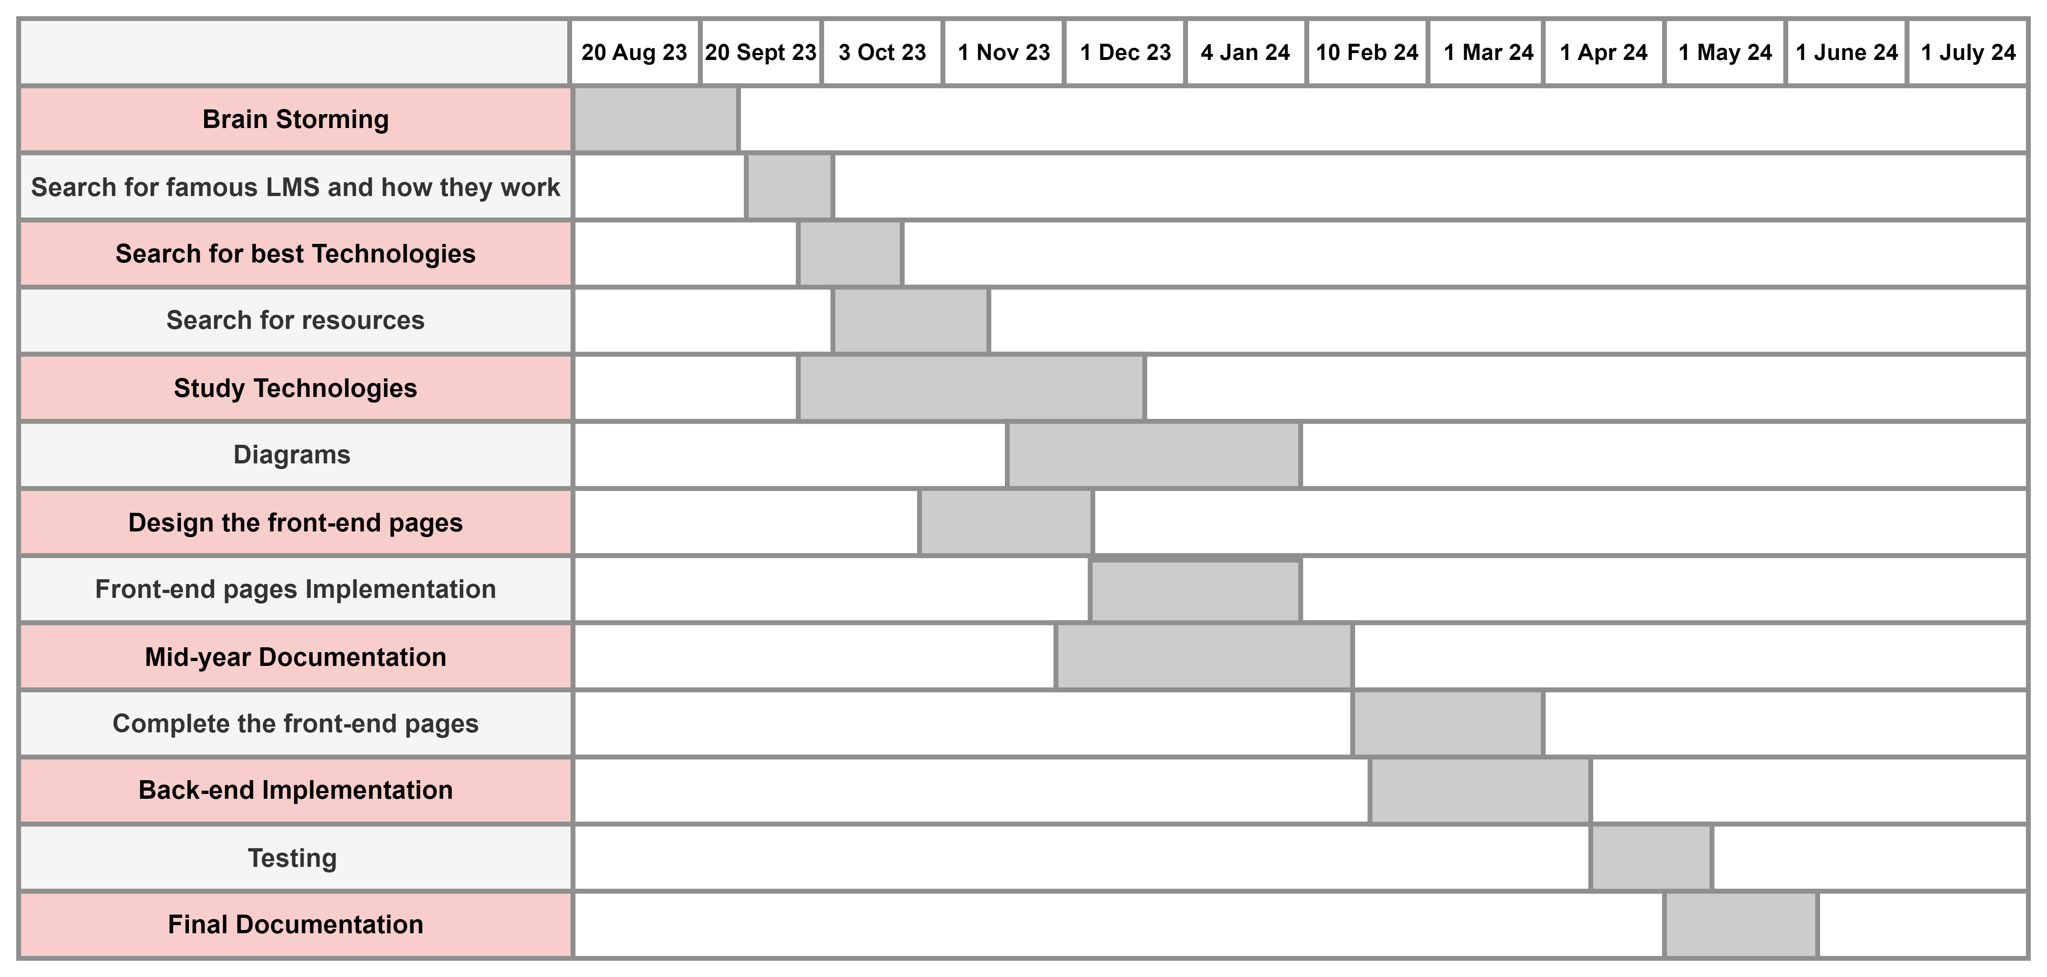
Time Plan

Slide 18
05
Conclusion

Slide 19
All the students and staff of the educational organization aspire to an easy life through learning and studying hard
Egyptian organizations want local applications that can make education easier at a lower budget compared to international applications
Eduology LMS can meet their needs
Through the ease of students’ access to materials
For the organization, payment is easy, and the price is affordable
And more comfortable for employees regarding tasks and grades
Conclusion

Slide 20
Thank You

